Slide 1
Gesture recognize 09-12-2016
Steven Wang

Slide 2
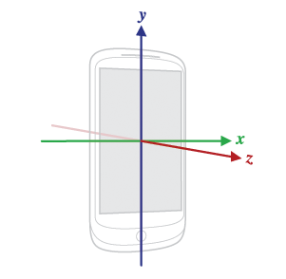
Previous question
The X axis is horizontal and points to the right
The Y axis is vertical and points up
The Z axis points towards the outside of the front face of the screen.
In this system, coordinates behind the screen have negative Z values.

Slide 3
Project plan
Phase 1: Offline model
Collect the gesture data in 2 seconds period
Find out the meaningful features
Find out the good performance classifiers
Phase 2: Real time model
Define the gesture event trigger time
Implement the features and classifier from phase 1 into android app.

Slide 4
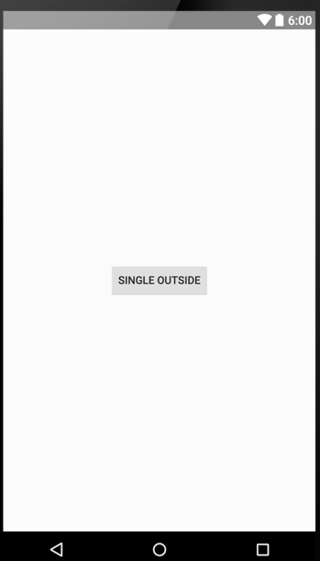

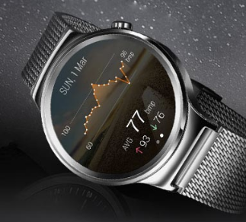
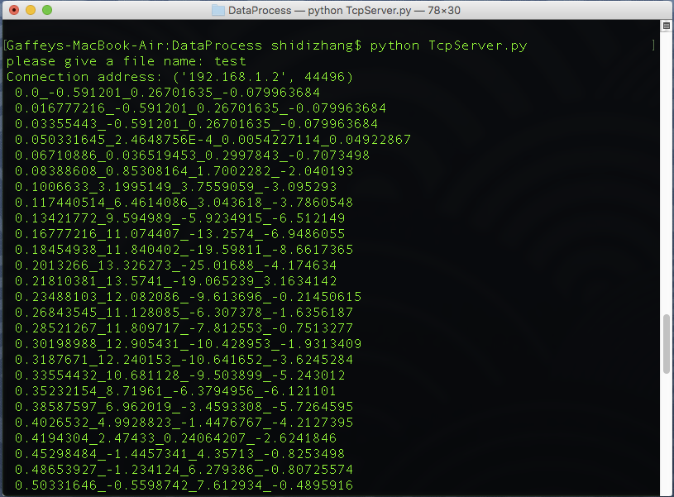
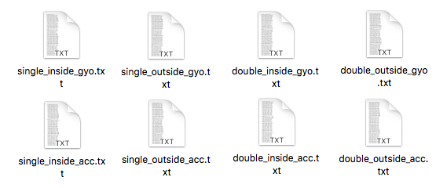
Data collection
Send the 2 seconds ACC and GYO data list to the laptop
Start Acc & Gyo sensor and record ACC(x, y, z) and GYO(x, y,z) for 2 seconds
Send record signal
Reformat and remove the dirty data
and save ACC and GYO
file separately
Send the 2 seconds ACC and GYO data list back to the phone

Slide 5
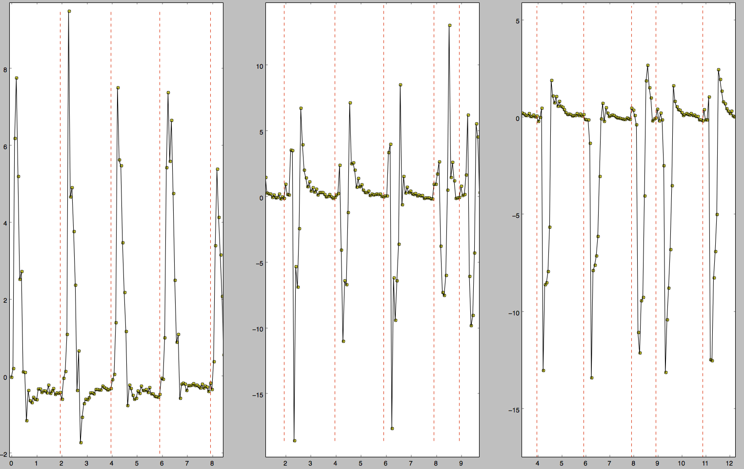
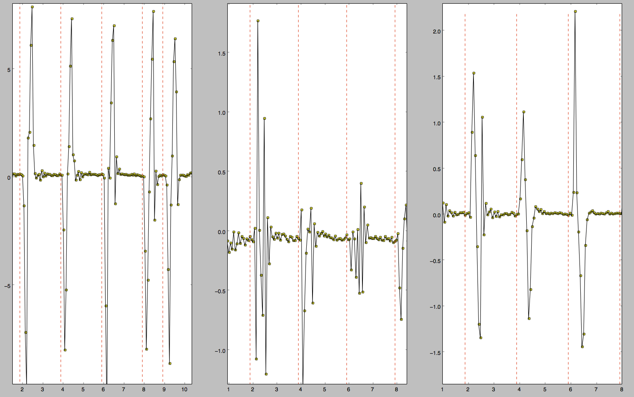
Rise the sample frequency
ACC_X
ACC_Y
ACC_Z
GYO_X
GYO_Y
GYO_Z

Slide 6
Data process
Step 1: read from one of the 8 files (single_inside_acc, single_inside_gry, single_outside_acc, single_outside_gry, double_inside_acc, double_inside_gry, double_outside_acc, double_outside_gry)
Step 2: for each line of the input stream, remove the none numerical character and uncompleted data (the data not in 3 dimension)
Step 3: synchronize the _acc and _gry files with the time stamp.
Step 4: concatenate the all the single inside, single outside, double inside and double outside files data.

Slide 7
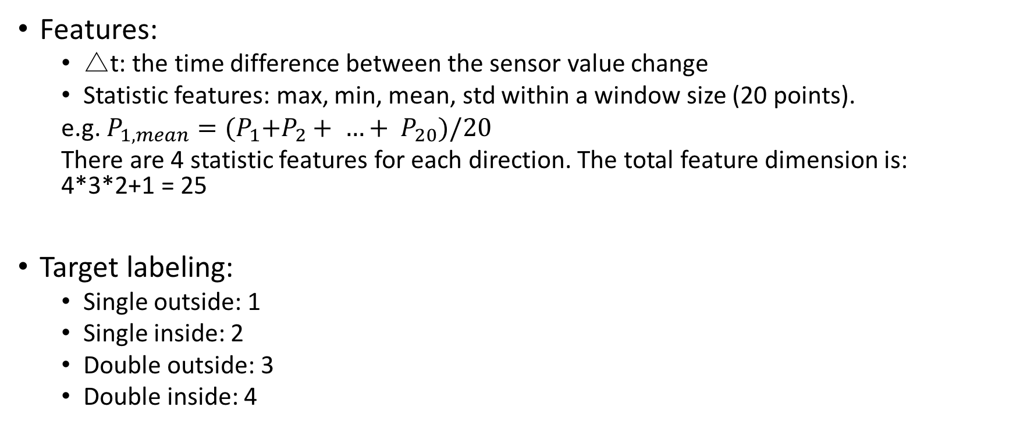
Feature extraction and target labeling
Features:
△t: the time difference between the sensor value change
Statistic features: max, min, mean, std within a window size (20 points).
e.g. $P_{1,mean}={(P}_{1}+P_{2}+ …+ P_{20})/20$
There are 4 statistic features for each direction. The total feature dimension is: 4*3*2+1 = 25
Target labeling:
Single outside: 1
Single inside: 2
Double outside: 3
Double inside: 4

Slide 8
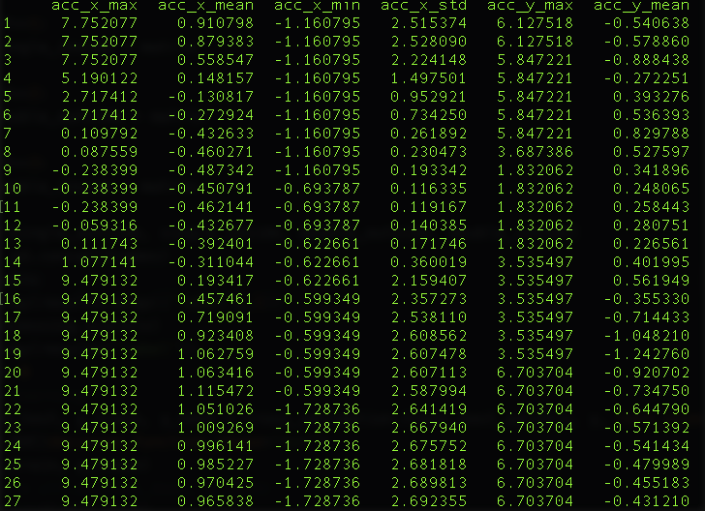
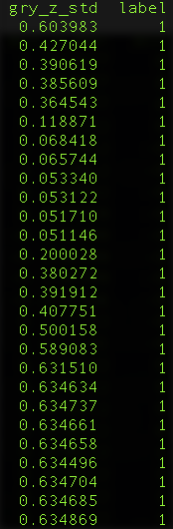
Data visualization
…

Slide 9
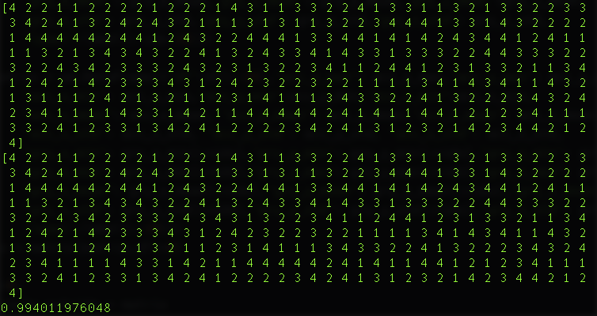
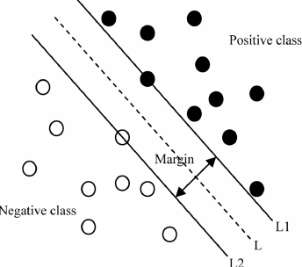
Machine learning model -- SVM
Given a set of training examples, each marked for belonging to several categories, an SVM training algorithm builds a model that assigns new examples into correct category. An SVM model is a representation of the examples as points in space, mapped so that the examples of the separate categories are divided by a clear gap that is as wide as possible.
Predict result
Label
accuracy

Slide 10
Train and test
After the data processing, 80 percentage of data is randomly selected as training data. The rest 20 percentage of data is for testing.
10 fold cross validation: average confidence is 97.10%
However, in the test demo program, the saved model performance is not very accurate.

Slide 11
Next step
Why the cross validation result is good but the test demo cannot perform well?
Recollect more sets (20~25) of training data for each guesture.
Make each class has the same sample data
Extract other meaning features:
Yaw, pich angle
Use a physical model instead of using machine learning

